Slide 1
CASE STUDY ASSESSMENT ON CREDIT RISK ANALYSIS

Slide 2
Content
The Task
Data Exploration and Cleaning
Data Structure and characteristics
Data Cleaning
Exploratory data Analysis (EDA)
Univariate Analysis & Categorical analysis
Credit risk analysis
Data Insight & Recommendation
Back up slides on Gender deep dive
Gender analysis by default
Predictive analysis (a basic logistic regression model)

Slide 3
The Task - Credit Risk Analysis Challenge
You will be given a small dataset GermanCredit.csv with data of customers applying for a loan. The data structure described in the Data section of this Document.
Tasks:
1. Data Exploration and Cleaning:
Perform exploratory data analysis (EDA) to understand the structure and characteristics of the dataset.
Identify and handle missing values, outliers, or any inconsistencies in the data.
2. Credit Risk Analysis:
Analyze the credit risk data, identifying trends and patterns.
Deliverables:
Visualization tool of choice (or similar):
Include your code, comments, and visualizations.
Ensure that your code is well-documented and easy to follow.
2. Presentation (PDF or PowerPoint):
Summarize your findings, insights, and recommendations.
Create visualizations to support your analysis.
Clearly communicate your thought process and the story behind the data.

Slide 4
The Task - Credit Risk Analysis Challenge
Dataset Name: Germancredit.sv
Data Dictionary
The target is the variable default.
The data has the following structure:
• Observation_id: unique observation id
• Checking_balance: Status of existing checking account. (German currency)
• Savings_balance: Savings account/bonds (German currency)
• Installment_rate: Installment rate in percentage of disposable income
• Personal_status: Personal status and sex
• Residence_history: Present residence since
• Installment_plan: Other installment plans
• Existing_credits: Number of existing credits at this bank
• Dependents: Number of people being liable to provide maintenance for
• Default: 0 is a good loan, 1 is a defaulting one.

Slide 5
Data Exploration and Cleaning
Data Exploration: Structure & Characteristics of GermanCredit.sv data
The German credit dataset contains 1000 rows and 23 columns
The column names, Row data count and data type are shown below. Here, the data has not been cleaned.
S/N | Column | Row Data Count | Data type
1 | Observation_id | 1000 non-null | int64
2 | checking_balance | 606 non-null | float64
3 | months_loan_duration | 1000 non-null | int64
4 | credit_history | 1000 non-null | object
5 | purpose | 1000 non-null | object
6 | amount | 1000 non-null | int64
7 | savings_balance | 817 non-null | float64
8 | employment_length | 938 non-null | object
9 | installment_rate | 1000 non-null | int64
10 | personal_status | 690 non-null | object
11 | other_debtors | 1000 non-null | object
12 | residence_history | 870 non-null | object
13 | property | 1000 non-null | object
14 | age | 1000 non-null | int64
15 | installment_plan | 1000 non-null | object
16 | housing | 1000 non-null | object
17 | existing_credits | 1000 non-null | int64
18 | default | 1000 non-null | int64
19 | dependents | 1000 non-null | int64
20 | telephone | 404 non-null | float64
21 | foreign_worker | 1000 non-null | object
22 | job | 1000 non-null | object
23 | gender | 1000 non-null | object
Data size: 1000 entries
Kind of data: The dataset contains a mix of data types (numeric and categorical dtype)
Possible missing values: checking_balance, savings_balance, employment_length, personal_status, residence_history, and telephone have non-null counts less than the total number of entries. This indicates that there might be missing values in these columns

Slide 6
Data Exploration and Cleaning
Data Cleaning of GermanCredit.sv data
Steps taken include
Checking and handling of missing data – Used Median Inputation
Checking for duplicates – There were no duplicates
Checking for Outliers – There were genuine outliers
Checking for data format before analysis – They were all in the right format

Slide 7
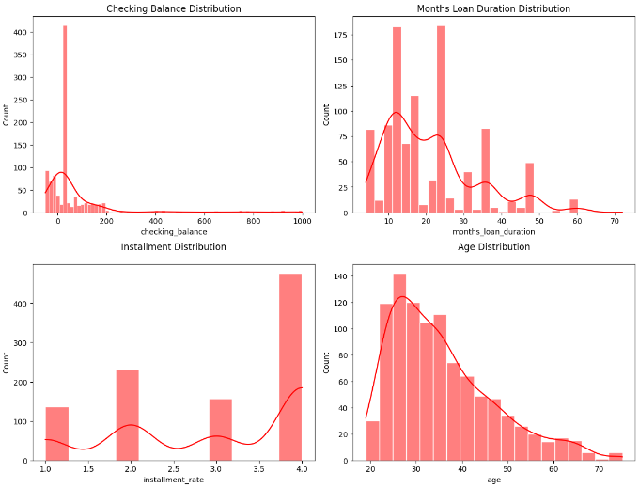
Exploratory Data Analysis (EDA) | Univariate Analysis
Univariate analysis: Focus on Numerical data analysis
Here we focus on key features that are likely to provide valuable insight to the dataset which include checking_balance, months_loan_duration, amount,, installment rate, age.
Trends/Patterns
Checking Balance: Most balances are low which may indicate financial strain and increased default
Month Loan Duration: Most loan durations are between 0-30months which are short-term to medium term loans
Installment Rates: Rates are highest in 2 or 4, indicating a significant portion of income is given to loan repayment, potentially increasing default risk if income drops.
Age: There are more Younger borrowers than Older individuals, which may affect risk and repayment capacity.

Slide 8
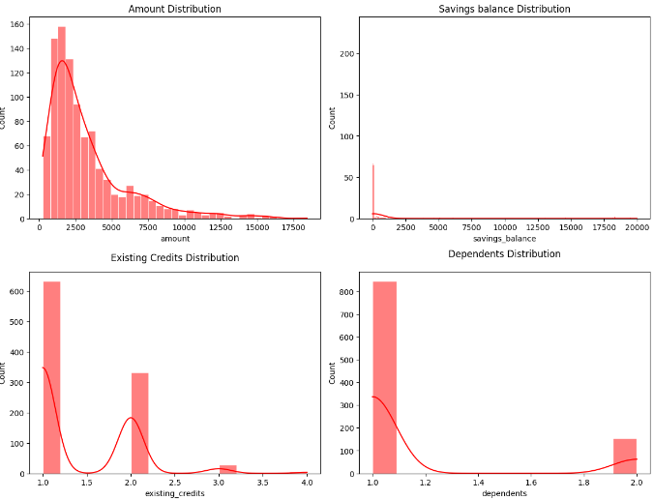
Exploratory Data Analysis (EDA) | Univariate Analysis
Univariate analysis: Focus on Numerical data analysis
Here we focus on key features that are likely to provide valuable insight to the dataset which include Amount, Savings_balance, Existing Credits distribution, Dependents distribution
Trends/Patterns
Amount: There are less higher loan amounts request naturally translate to lower risk for the lender.
Savings balance: Most borrowers have low savings balances, which could lead to increased financial risk.
Existing Credit: Most individuals have fewer existing credits/loans which could suggest lower credit risk.
Dependents: Most individuals have fewer dependents, which may suggest a lower risk of default.

Slide 9
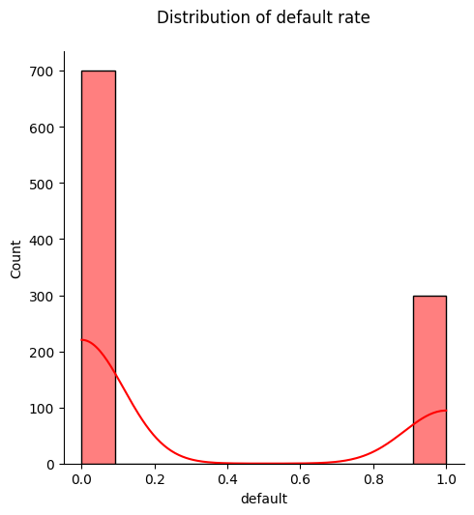
Exploratory Data Analysis (EDA) | Univariate Analysis
Univariate analysis: Focus on Numerical data analysis
Here we focus on key features that are likely to provide valuable insight to the dataset which include Default rate
Trends/Patterns
Amount: There are higher good loans than bad loans.
Further analysis will be done to discover the drivers of bad loans.

Slide 10
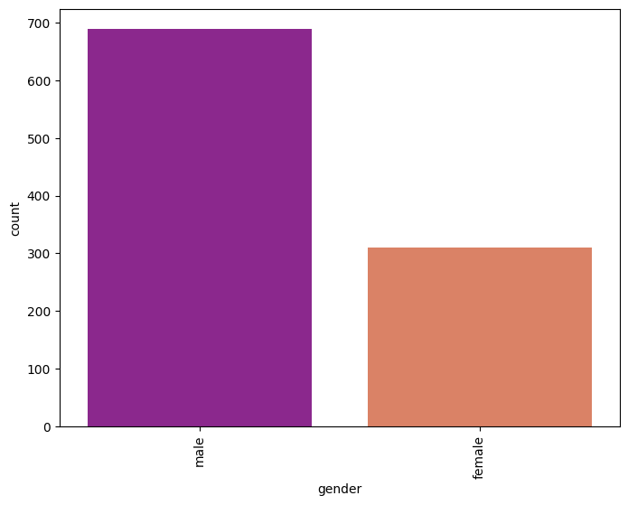
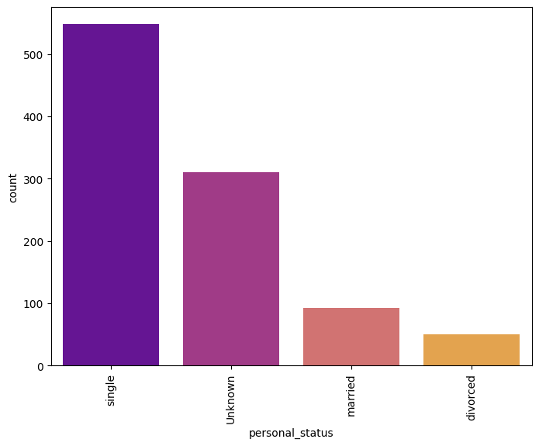
Exploratory Data Analysis (EDA) | Univariate Analysis
Univariate analysis: Focus on Categorical data analysis
Here we focus on key features that are likely to provide valuable insight to the dataset such as Gender and Personal status
More than half of the borrowers are men who are single

Slide 11
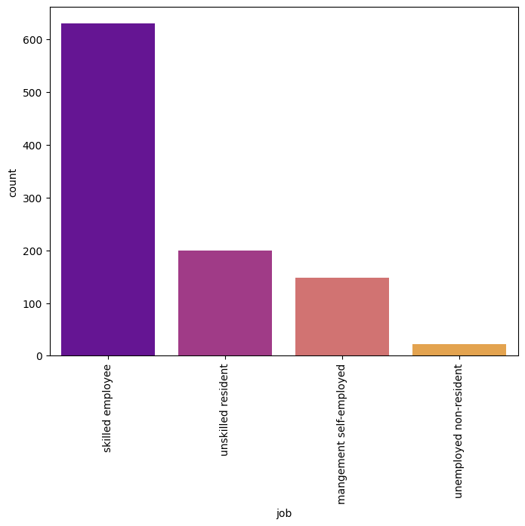
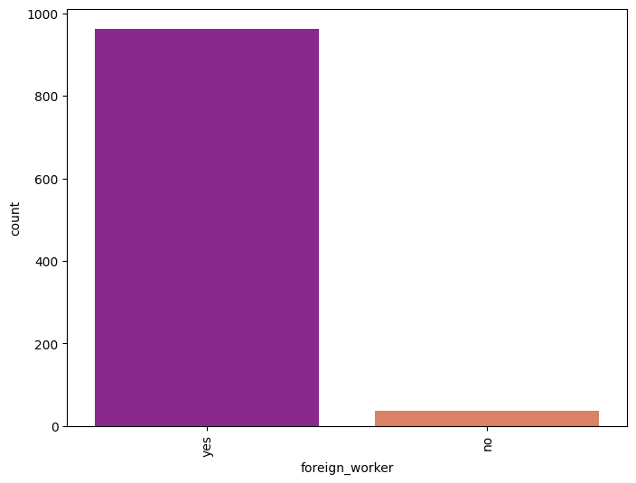
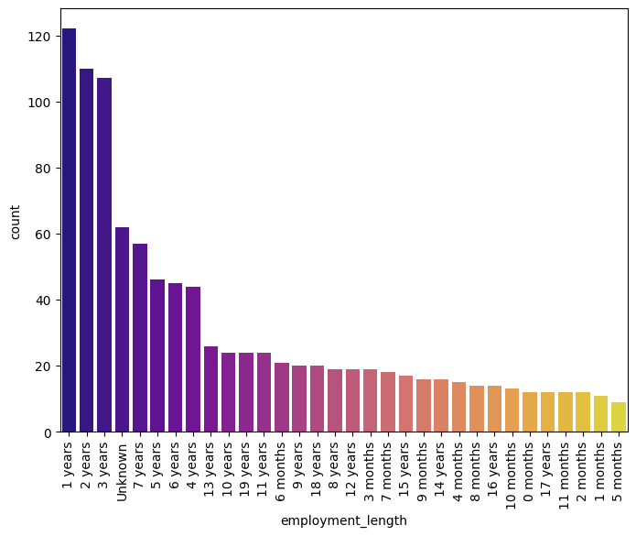
Exploratory Data Analysis (EDA) | Categorical data analysis
Univariate analysis: Focus on Categorical data analysis
Here we focus on key features that are likely to provide valuable insight to the dataset which include Job, Foreign worker, Employment length
Most of the borrowers are foreign workers who are either skilled employees, unskilled residents, management self employed or unemployed non resident with 1-7 years of experience.

Slide 12
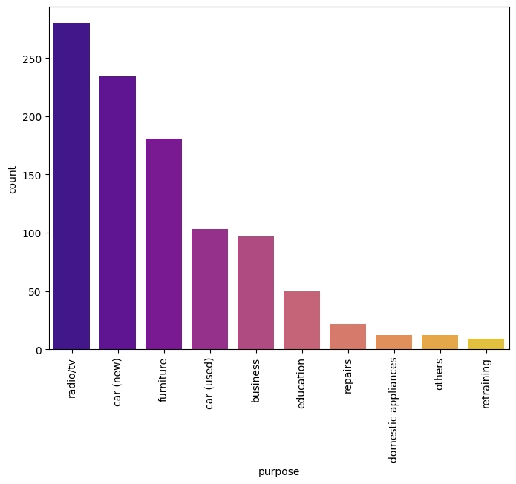
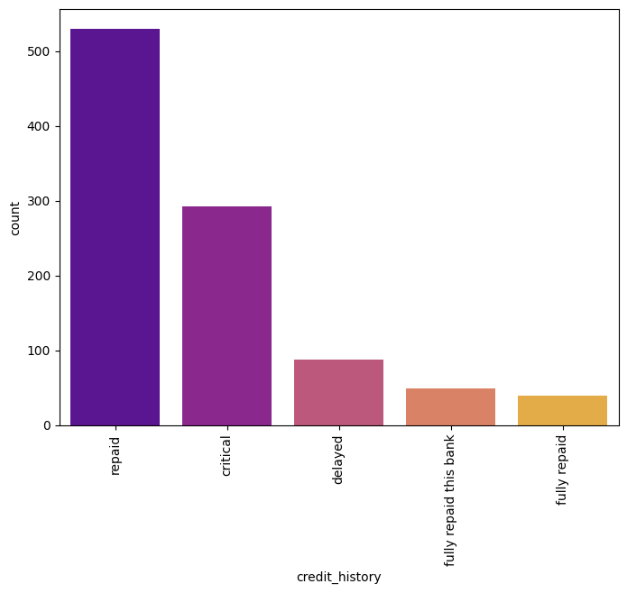
Exploratory Data Analysis (EDA) | Categorical data analysis
Univariate analysis: Focus on Categorical data analysis
Here we focus on key features that are likely to provide valuable insight to the dataset which include Purpose and Credit History
Most of the borrowers took loans to purchase radio radios, new cars and furniture.
The credit history of borrowers who took loans were mostly split between repaid and critical and others.

Slide 13
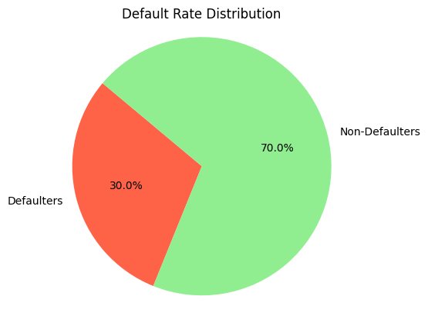
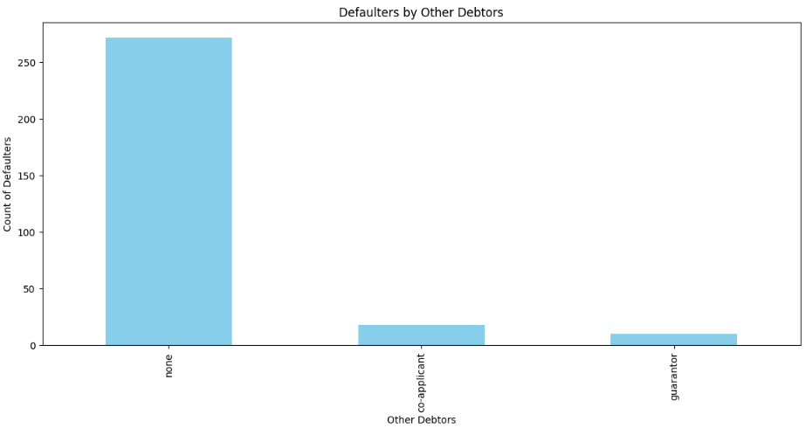
Credit Risk Analysis
Here, we seek to understand the driver of default rates, the target data.
Here we understand default levels and analyze default rate by other debtors to find out “Who” are defaulting.
30% of the loans are defaulted loans.
Of the defaulted loans the highest number are “none” which signify loans where there were no co-applicant and guarantor provided before accessing the loan

Slide 14
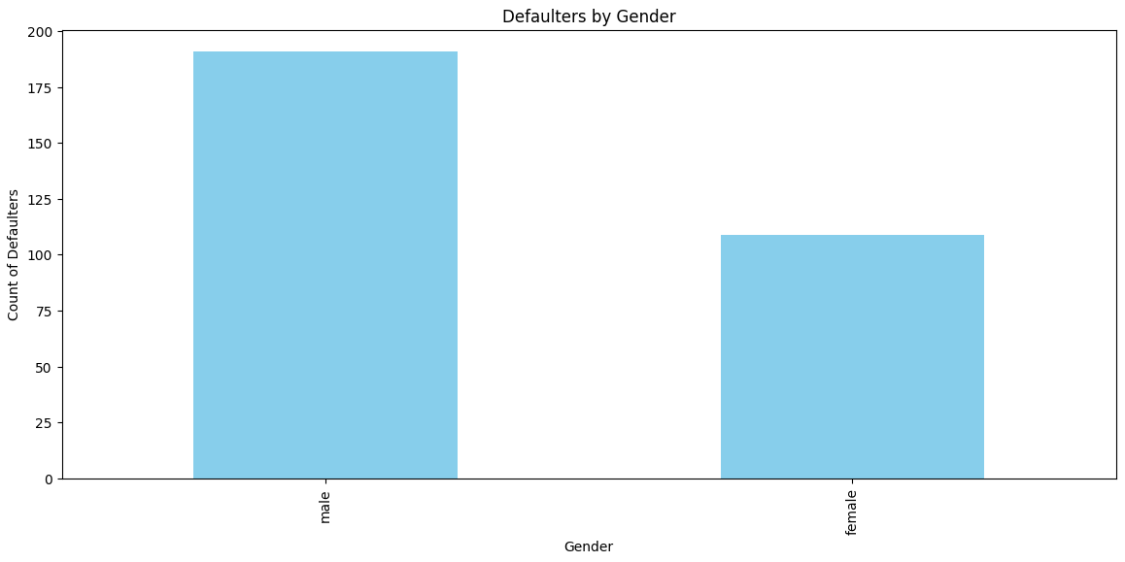
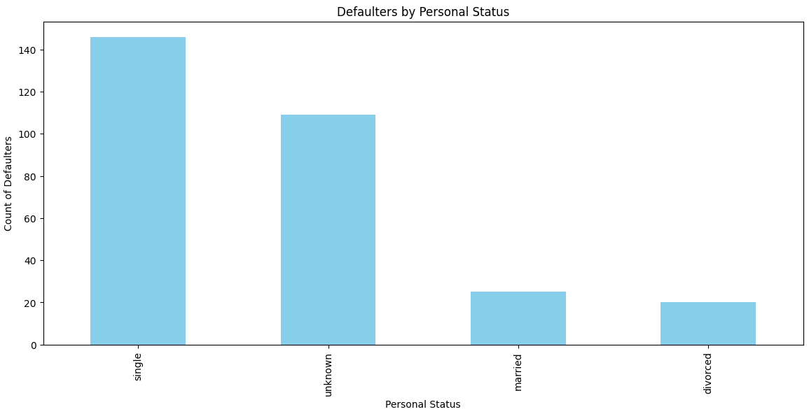
Credit Risk Analysis
Here, we seek to understand the data in the context of the default rates, the target data.
Here we seek to discover “Who” are defaulting by analyzing default rate by gender and default rate by personal status
Who are the defaulters? While both gender default, there are more male defaulters than female defaulters.
Also, the majority of the individuals who default are Single and unknown.

Slide 15
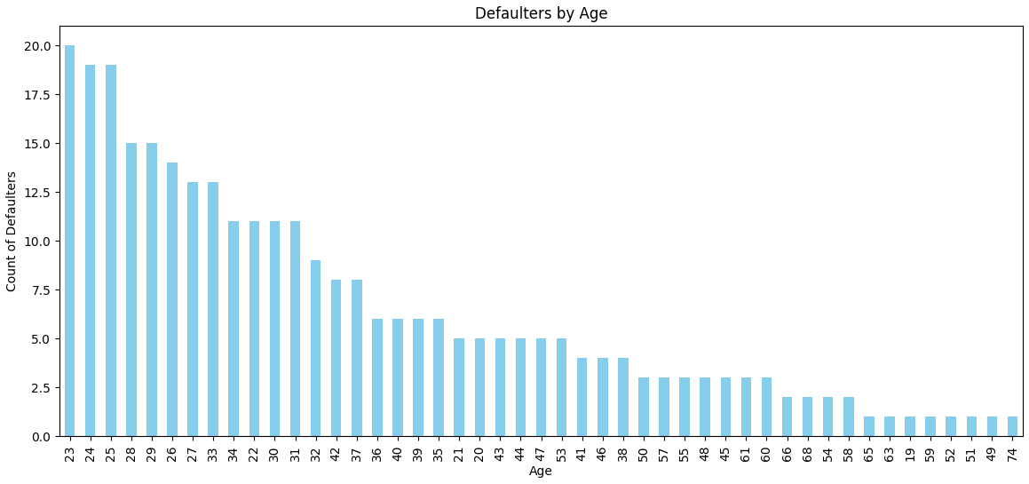
Credit Risk Analysis
Here, we seek to understand the data in the context of the default rates, the target data.
Here we seek to discover “Who” are defaulting by analysing defaulters by age
Who are the defaulters? The age of the defaulters are mixed indicating that anyone can default. However, Majority of the defaulters are younger individuals (23 - 32). The most of the older individuals have lower default rates.

Slide 16
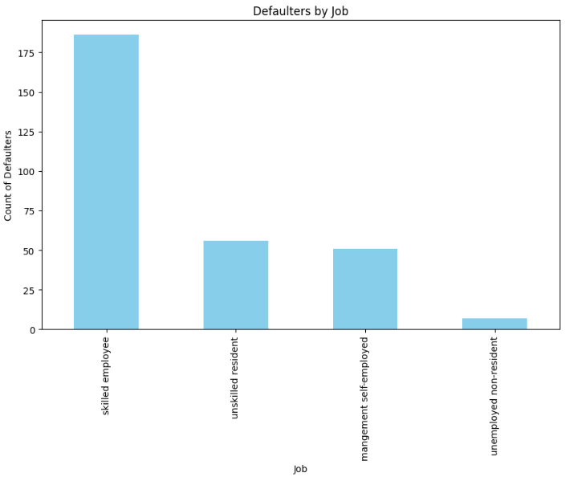
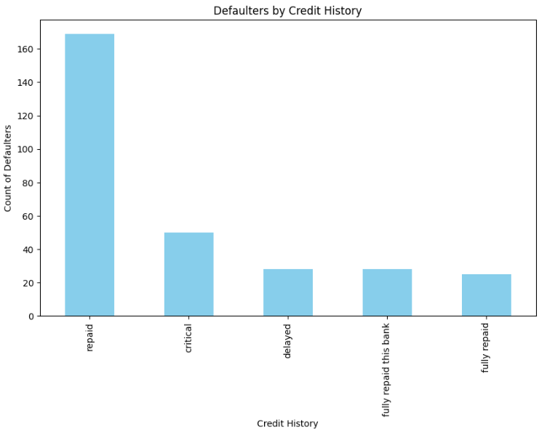
Credit Risk Analysis
Here, we seek to understand the driver of default rates, the target data.
Here we seek to discover “Who” are defaulting by analyzing defaulters by job and defaulters by Credit history
Who are the defaulters? Most individuals that default are skilled employees. They also had good credit history.

Slide 17
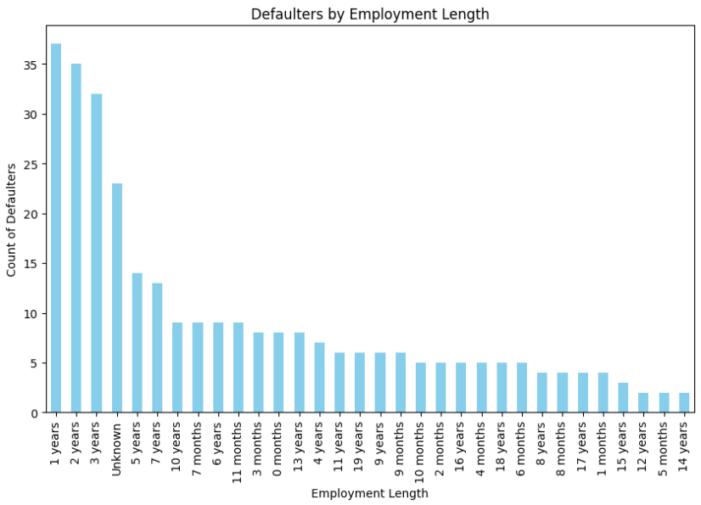
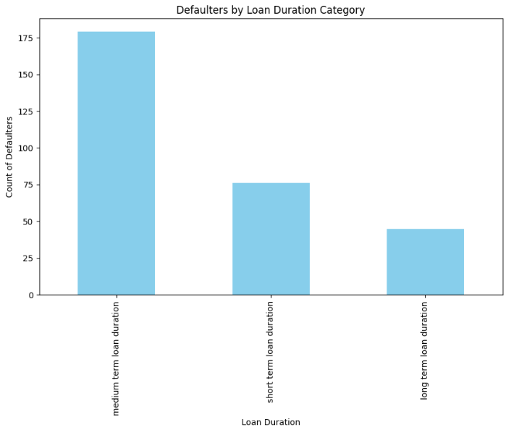
Credit Risk Analysis
Here, we seek to understand the data in the context of the default rates, the target data.
Here we seek to discover “Who” are the people defaulting by analysing default rate by employment length and default rate by loan duration category
Employment length of the individuals are within 1-7 years. As such the demography is dominated by young individuals with few years of experience.
Also most loans being defaulted are medium term loans (13-36mths) and short-term loans (0-12mths).
Also this likely also corroborates the demography single young individuals with few years of experience who are likely just beginning their life.

Slide 18
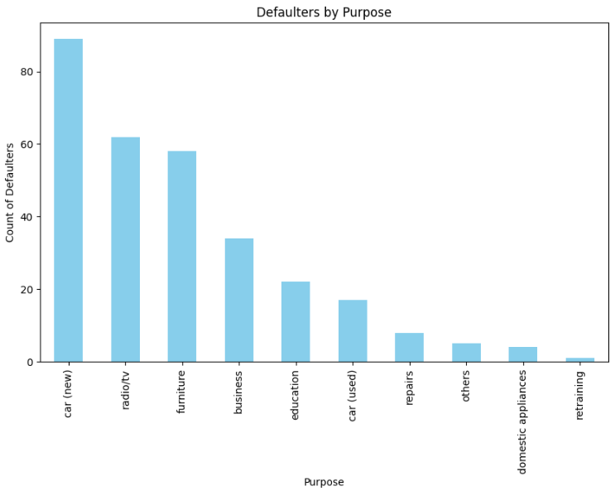
Credit Risk Analysis
Here, we seek to understand the data in the context of the default rates, the target data.
Here we seek to discover “What the loans are for” by analyzing defaulters by purpose
What are the loans for and why are they defaulting? Most individuals that defaulted used the loans on new cars radio/tv and furniture which are not income generating assets but consumer durables.
Also this likely also corroborates the fact that most of the demography of borrowers are single young male and females with few years of experience.

Slide 19
Insights and Recommendations
Summary of Insights
More than half of the borrowers are Single men
Most of the borrowers are foreign workers who are either skilled employees, unskilled residents, management self employed or unemployed non resident with 1-7 years of experience
Most of the borrowers took loans to purchase radio radios, new cars and furniture. The credit history of borrowers who took loans were split between repaid and critical and others.
30% of the loans are defaulted loans. Of the defaulted loans the highest number are “none” which signify loans where there were no co-applicant and guarantor.
The age of the defaulters are mixed indicating that anyone can default. However, Majority of the defaulters are younger individuals (23 - 32). The most of the older individuals have lower default rates
Most individuals that default are skilled employees. They also had good credit history.
Most individuals that default defaulted on medium term loans which we categorized as (13 – 36 months).
Most individuals that defaulted used the loans on new cars radio/tv and furniture which are not income generating assets but consumer durables
Summary of Recommendations
Loan applicants/borrowers must have a guarantor or co-applicant before a loan is given to them.
Cap the loan amounts offered to borrowers with other debtors to reduce risk
There should be increased targeting of loans towards married individuals as they have a high tendency to not default as the income streams of two people can service the loan.
Business loans should be encouraged although they carry inherent risks but are likely to yield returns that support repayment.
We recommend the development of a predictive model to flag potential defaulters in other to reduce bad debts

Slide 20
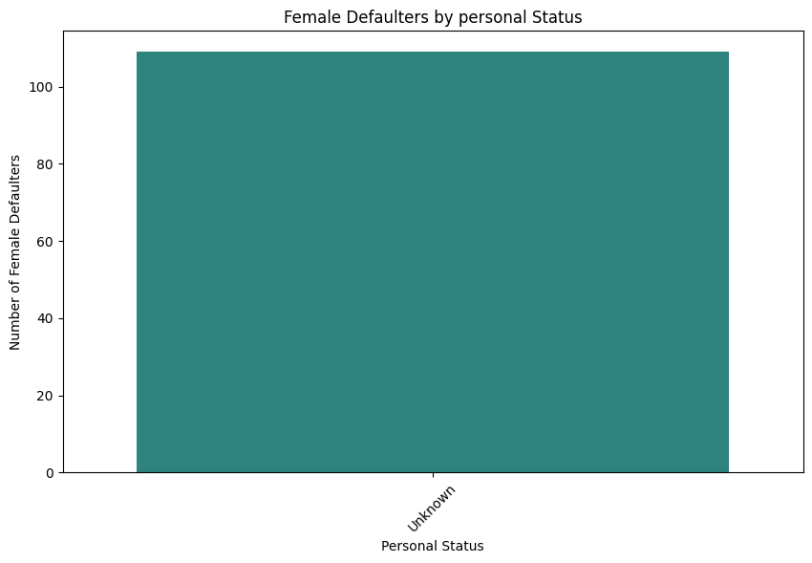
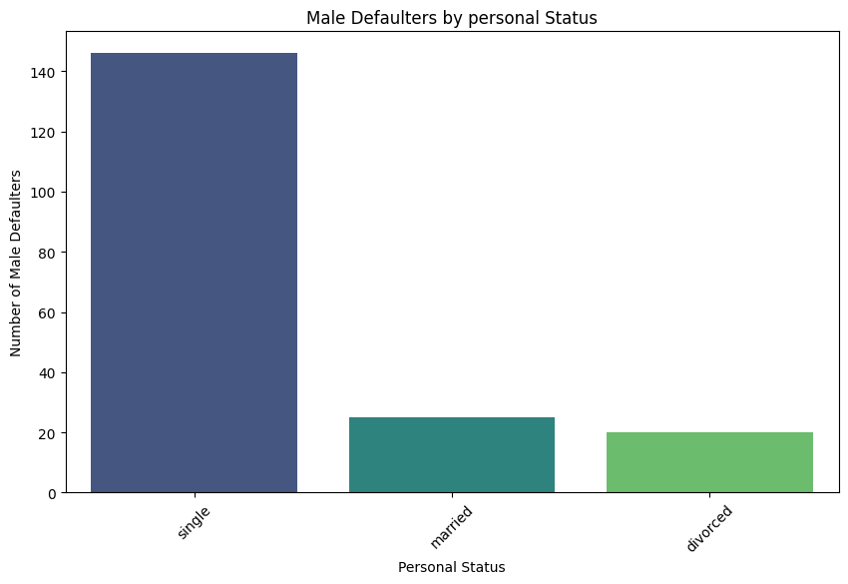
Credit Risk Analysis
Here, we seek to understand the data in the context of the default rates, the target data.
Here we seek to discover “Who” are the people defaulting ng from defaulters by personal status
Females mostly unknown. Males mostly single

Slide 21
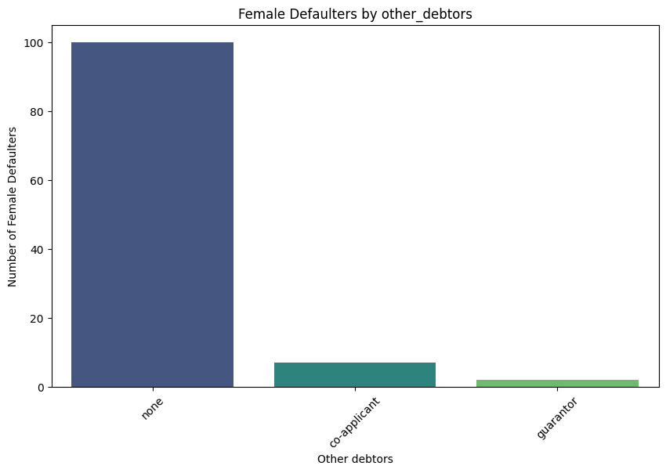
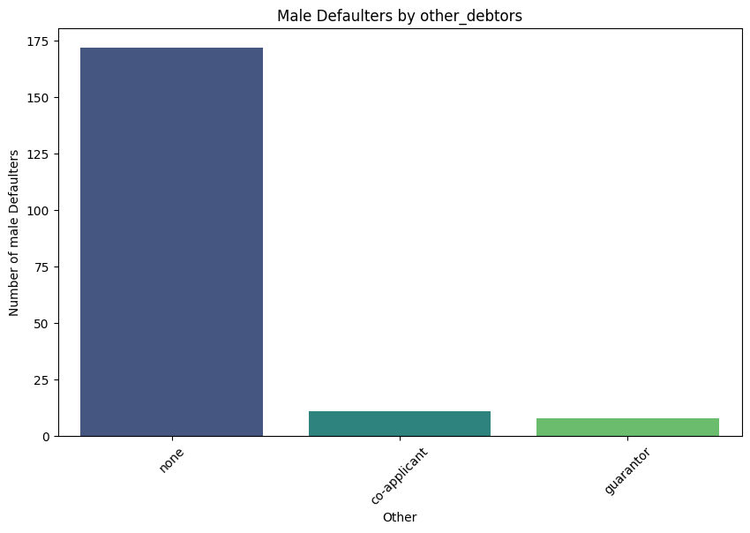
Credit Risk Analysis
Here, we seek to understand the data in the context of the default rates, the target data.
Here we seek to discover “Who” in the different Genders are defaulting using default rate by other debtors
Both Males and Females that default are mostly none (do not have guarantors or coapplicants)

Slide 22
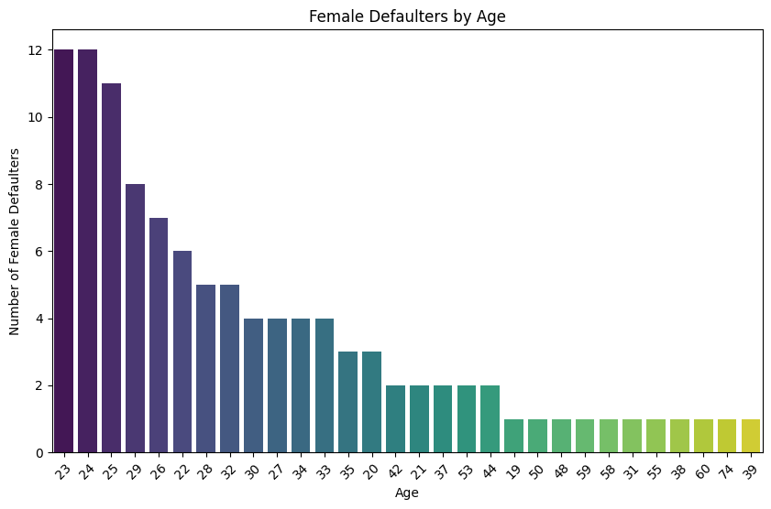
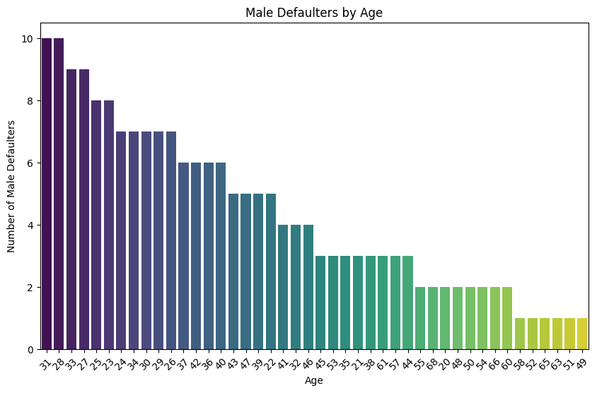
Credit Risk Analysis
Here, we seek to understand the data in the context of the default rates, the target data.
Here we seek to discover “Who” in the different Genders are defaulting using default rate by age
Both Males and Females are young who default Males (23-33), Females (23-29)

Slide 23
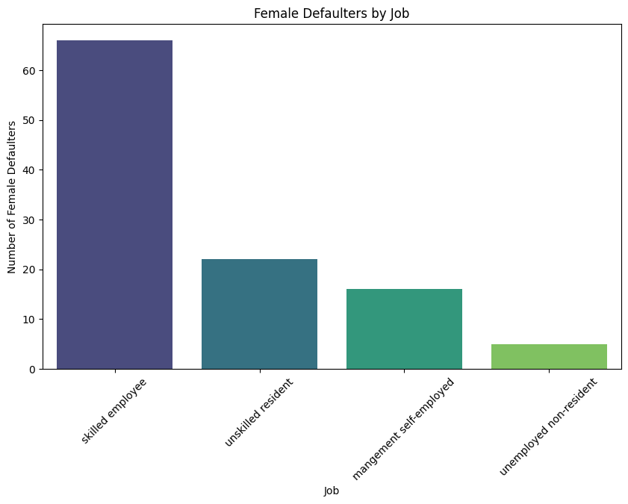
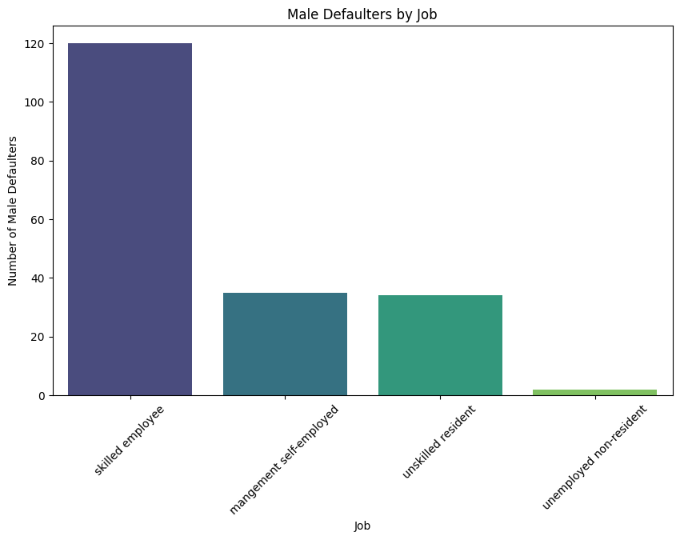
Credit Risk Analysis
Here, we seek to understand the data in the context of the default rates, the target data.
Here we seek to discover “Who” in the different Genders are defaulting using default rate by other job
Both Males and Females defaulters are mostly skilled employee. Others are unskilled resident and management self-employed

Slide 24
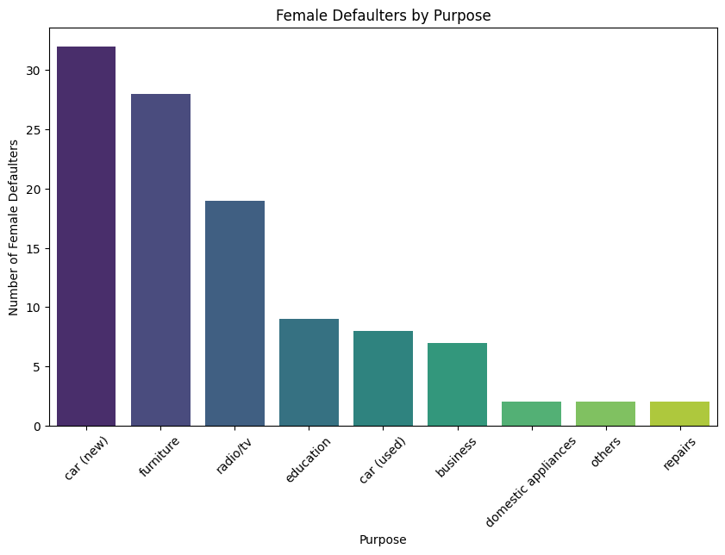
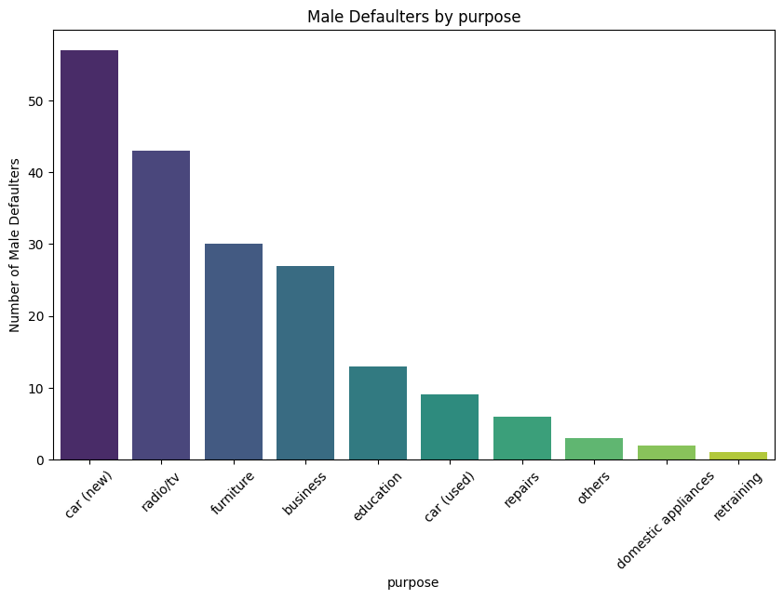
Credit Risk Analysis
Here, we seek to understand the data in the context of the default rates, the target data.
Here we seek to discover “What and why” in the different Genders are defaulting using default rate by other job
Both Males and Females that spent the money on new car hire, furniture, radio/tv.

Slide 25
Predictive Analysis
Here, we aim to identify the most significant predictors of the default rate using a basic logistic regression model.
The model identifies around 47.5% of actual default cases.
The ROC-AUC score is 0.509, indicating performance only slightly better than random guessing.
A score of 0.8+ is typically ideal for distinguishing defaulters from non-defaulters.
Key predictive features include;
Loan duration months
Purpose (car)

